Slide 1
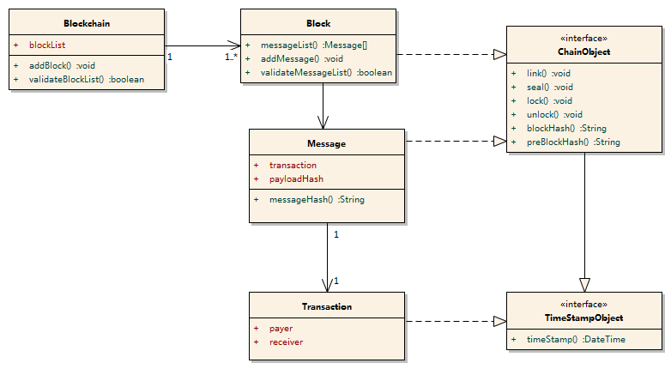
Static View(overview)

Slide 2
SideChain
Specific Subject TX
1.Wirte messages
Current Block
2.Async lock
3.SideChain process
lock
unlock
MainChain
5.Async unlock and continue Mainchain process
SideChain
4.Return from SideChain
for Performance Improvement
Subject focused SideChain between semi-centric stakeholders, geographic application, business cases, or etc.

Slide 3
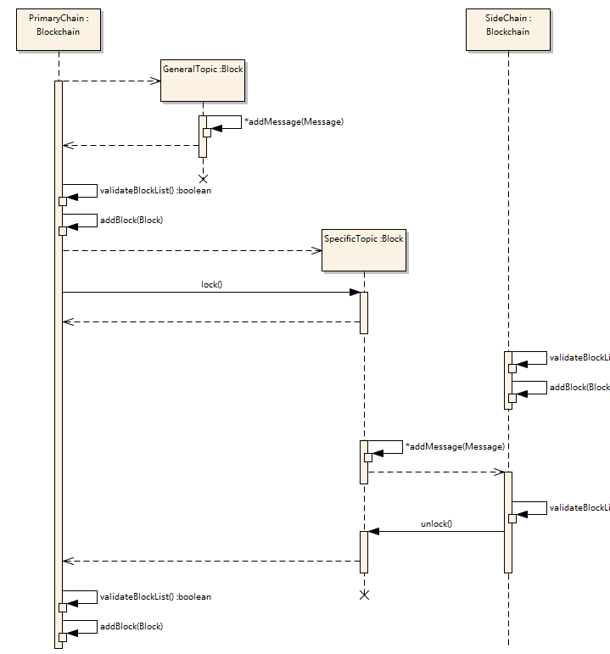
SideChain Dyanmic View
Normal process
SideChain 2(or N) process

Slide 4
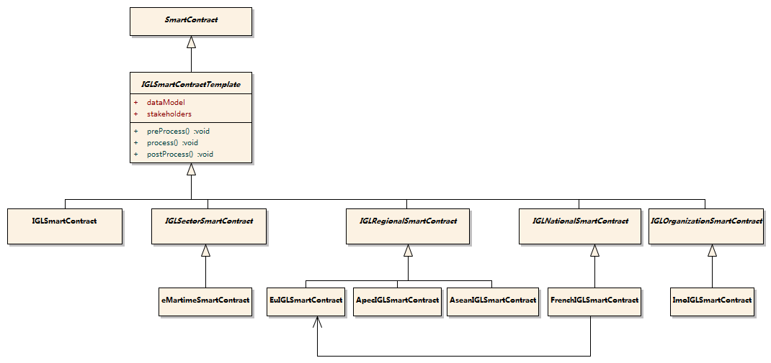
Smart Contract Template
Productivity, Standardized and Easy for Extension
Reuse of Data Model and Stakeholder Definition

